Slide 1
HACKATHON 7: EYES ON EARTH | SDG 15 LIFE ON LAND
Invasive Plant Spotter
Detecting Japanese knotweed and giant hogweed in photos from the Netherlands
Dylan and Ana | HHS AI for Good 26/27 | Tool: Roboflow

Slide 2
THE PROBLEM AND WHO IT IS FOR
Two invasive plants, one real problem
• Japanese knotweed damages paving, dikes and foundations.
• Giant hogweed sap causes severe burns and scarring when skin meets sunlight.
• Both crowd out native plants along riverbanks, parks and roadsides.
• Who needs it: municipal green-space teams, water boards and volunteer groups, who must find these plants early.
• SDG 15, target 15.8: prevent and reduce the impact of invasive alien species.
• Our answer: a screening aid. A person confirms every finding.
Problem framing: Ana's slide, shortened.

Slide 3
DATASET
Data: 415 scraped photos, none of our own
• Source: iNaturalist, research grade observations in the Netherlands.
• 215 Japanese knotweed + 200 giant hogweed, licence CC BY or CC BY-NC, up to 3 photos per observation.
• No own photos: it is autumn and the plants are dying back. Autumn and winter photos were picked first.
• Author, licence and link of every photo are listed in data/sources.csv.
• Boxes made by Roboflow Auto Label. We checked 14 images and deleted 1 stray box.
• Random split by image: 291 train, 83 valid, 41 test.

Slide 4
RESULTS ON THE 41 TEST IMAGES
Model: RF-DETR Small trained in Roboflow
90.5%
mAP@50
98.0%
Precision
82.5%
Recall
89.4%
F1
• When it draws a box it is almost always right (98% precision), but it misses about 1 in 6 plants.
• Treat the scores as promising, not as field accuracy: the test boxes also came from Auto Label, and photos of the same observation can sit in both train and test.
• Two classes only: japanese_knotweed and giant_hogweed.

Slide 5
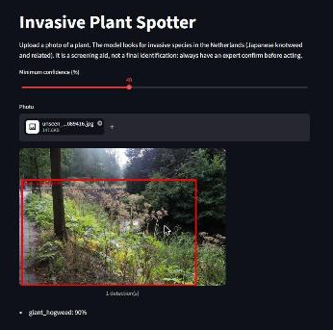
STREAMLIT APP
Live demo: upload a photo, get boxes and confidence
• Run: python -m streamlit run app.py
• Three new photos the model never saw: hogweed 90%, knotweed 93%, knotweed 99%.
• On one knotweed photo the box covered only the upper part of the plant.
• Three photos is a sanity check, not an evaluation.
Demo photo: Peter Hollings-Scott, iNaturalist observation 395443468, CC BY-NC.

Slide 6
LIMITATIONS AND ETHICAL REFLECTION
What could go wrong, and our safeguards
• False negative: an invasive plant spreads unnoticed, and hogweed near paths can burn people.
• False positive: a native plant is sprayed, or a landowner is wrongly blamed.
• Look-alikes such as giant cow parsley and angelica were never tested.
• Narrow data: two classes, Dutch photos only, mostly taken by people who already knew the plant.
• Safeguards: screening aid only, an expert confirms every detection, and the app never encourages anyone to touch or approach a plant.
Full reflection: ETHICS.md in the repo.

Slide 7
LESSONS
What we learned and what we would do next
• A high score is not proof: an AI made the labels and we checked only 14 of 415.
• Look at images at full size. Thumbnails made two good boxes look wrong.
• Scraped data is fast, but gives no control over season or look-alikes.
• Next: label by hand, test look-alikes and winter canes, and split the data by observation.
Code, README and ethics: github.com/landinh0804/ai4g-portfolio-Dylan, Term 1/Week 7/hackathon

